Slide 1


Mention the Project Title of the Proposed Idea or Innovation
Government of India Ministry of Micro, Small & Medium Enterprises
MSME IDEA Hackathon 5.0
Team members’ details
Sl.No. | Name (Start with Applicant/Incubatee) | Student Reg. No.,Class, Dept.. | Mobile No./Email | Industry details (If others / entrepreneurs / MSMEs) | Aadhar No(Mandatory) / Udhyog Aadhar No/ Udyam Registration (If any)
01 | JANE HANNAH S | 727824TUAM018 | 9489130622/727824tuam018@skct.edu.in | STUDENT | 428587725143
02 | JASWANTH RAJ K | 727824TUEE050 | 9345605500/727824tuee050@skct.edu.in | STUDENT | 456119532019
03 | KARISHMA T | 727824TUEE053 | 9894853133/727824tuee053@skct.edu.in | STUDENT | 382358183915
04 | MAGHIZHAN K R | 727824TUAM027 | 7339356724/727824tuam027@skct.edu.in | STUDENT | 318072782007
Sector :
Mentor Details
(Use any one) Mr./Ms./Dr. _ ELAKYA _______
Department of __EEE ___
Sri Krishna College of Technology
Email ID: a.elakkiya@skct.edu.in , Mobile No. 9578981476

Slide 2
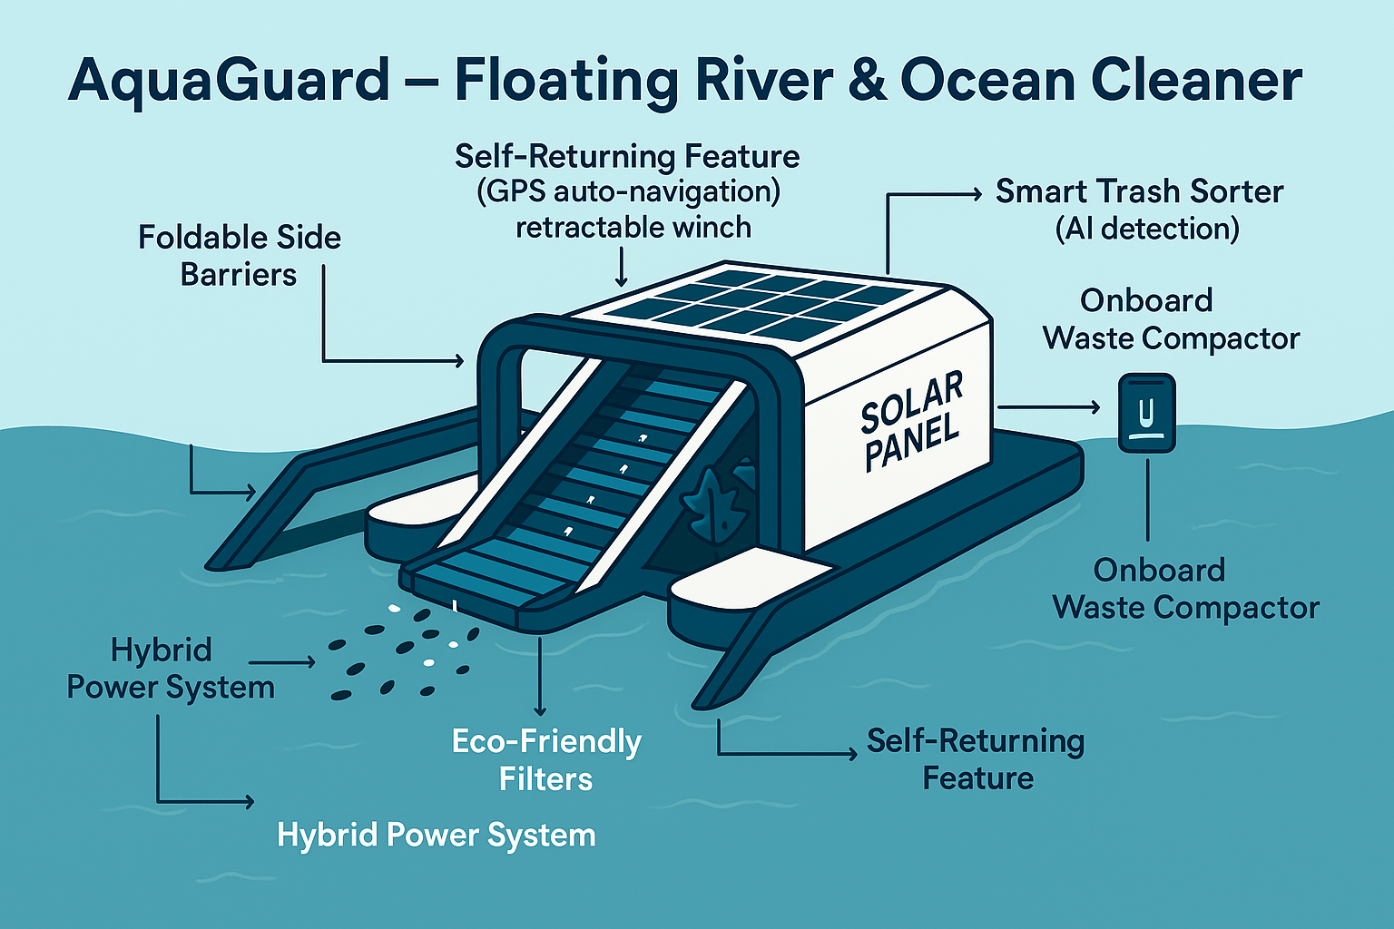
INNOVATION AND SUSTAINABILITY IN COASTAL AREAS

Slide 3
Problem Identification
Every year, over 11 million metric tons of plastic waste enter the ocean, and up to 80% of it comes from rivers.
Floating waste clogs waterways, harms marine animals, and breaks down into microplastics that contaminate the food chain.
Current cleanup solutions are slow, labor-intensive, and fuel-powered, making them costly and environmentally unsustainable.
Collected waste often fills boats quickly, forcing frequent trips to shore, which increases operational costs and reduces cleanup efficiency.

Slide 4
Background for getting the idea/innovation
Who it is for?
Coastal towns, riverfront cities, ports, and environmental NGOs.
What will it do?
Autonomous Cleanup – Patrols rivers, harbors, or coasts using GPS, guiding waste in with foldable barriers
Microplastic Filtration – Cleans return water by capturing harmful microplastics safely.
Onboard Compaction – Compresses collected waste to maximize storage and reduce offloading trips.
Renewable Operation – Runs entirely on solar power with tidal/battery backup, returning to dock automatically when full or low on power.

Slide 5
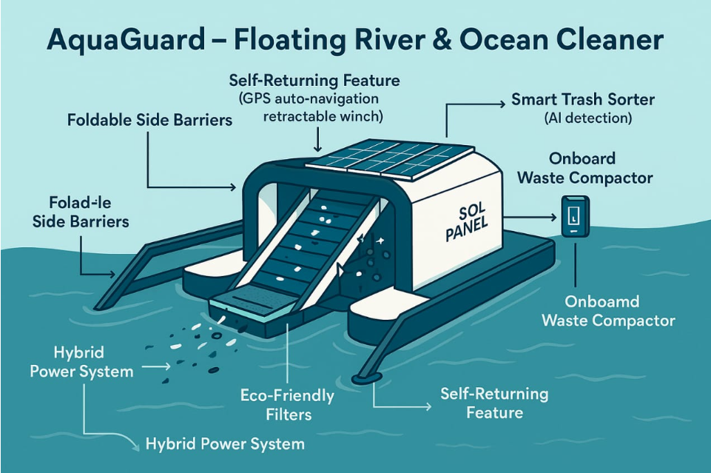
Newness/uniqueness of the innovation
Trash Trapping Module
Extended arms or net structure
Guides floating trash toward the intake
Trash Gathering Module
Conveyor belt or suction mechanism
Transfers debris into the trash container
Potential Enhancements
Solar-powered operation
AI-based obstacle detection
Modular storage bins
GPS tracking and remote monitoring
Real-time pollution data reporting
Note: Use bullet points with maximum of 7 lines. Avoid Paragraph. Include Pictures wherever required

Slide 6
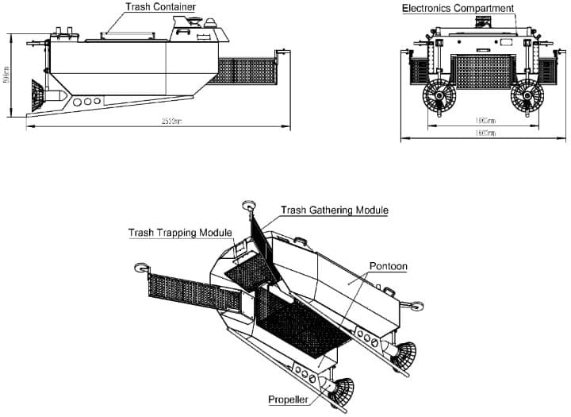
Objective(s) of the idea/innovation
Major Components
Trash Container
Stores collected debris
Large capacity for extended operation
Electronics Compartment
Contains sensors, controllers, batteries
Enables autonomous navigation
Propulsion System
Twin propellers for movement and steering
System Dimensions
Overall Length: ~253 cm
Overall Width: ~196 cm
Height: ~87 cm
Compact Size: Allows operation in narrow water channels
Note: Use bullet points with maximum of 7 lines. Avoid Paragraph. Include Pictures wherever required

Slide 7
Potential areas of application in industry/market in brief
Note: Use bullet points with maximum of 7 lines. Avoid Paragraph. Include Pictures wherever required

Slide 8
Market data for the potential idea/ innovation
Note: Use bullet points with maximum of 7 lines. Avoid Paragraph. Include Pictures wherever required

Slide 9
Current development status of idea/innovation by applicant/incubatee
Note: Use bullet points with maximum of 7 lines. Avoid Paragraph. Include Pictures wherever required

Slide 10
Literature Survey/Prior art on the concept, if any
Note: Use bullet points with maximum of 7 lines. Avoid Paragraph. Include Pictures wherever required

Slide 11

Solution Proposed (with Block diagram/ 3D Model/ flow chart/ Circuit Diagram / Pictures)
Note: Use bullet points with maximum of 7 lines. Avoid Paragraph. Include Pictures wherever required

Slide 12
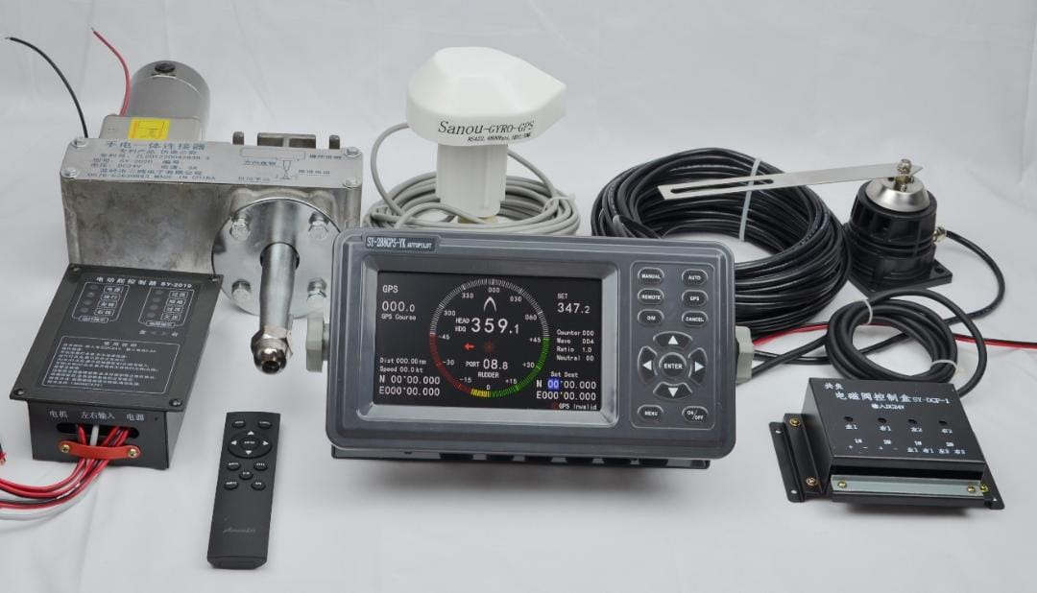
Solution Proposed (with Block diagram/ 3D Model/ flow chart/ Circuit Diagram / Pictures)
Remote Tracking & GPS Integration
Equipped with a GPS module for real-time location tracking
Tracks the robot's position on a live map interface via mobile or web app
Remote access through Wi-Fi, 4G/5G, or LoRa communication modules
Precise geolocation helps monitor cleaning routes and progress
Enables route planning and geofencing to clean specific zones
Receives automated navigation commands from a central control system
Triggers alerts if the robot deviates from assigned cleaning area
Stores historical path data for performance analytics and optimization
Emergency override feature to stop or redirect the robot remotely
Note: Use bullet points with maximum of 7 lines. Avoid Paragraph. Include Pictures wherever required

Slide 13
How you actually make, assemble, synthesize, or build the solution?
Note: Use bullet points with maximum of 7 lines. Avoid Paragraph. Include Pictures wherever required

Slide 14
How simple or complex will the idea’s execution or implementation be? What are the risk factors involved in executing the idea?
Note: Use bullet points with maximum of 7 lines. Avoid Paragraph. Include Pictures wherever required

Slide 15
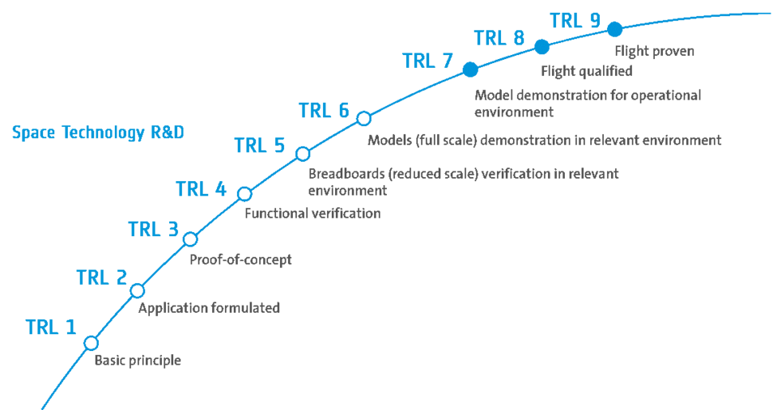
How soon could the idea be put into operation? (TRL of prototype)
Indicated your project TRL
Note: Use bullet points with maximum of 7 lines. Avoid Paragraph. Include Pictures wherever required

Slide 16
Workplan/Timeline (Monthlywise – Chart)
Note: Use bullet points with maximum of 7 lines. Avoid Paragraph. Include Pictures wherever required

Slide 17
Technology related Expenditure
Technology related Expenditure towards machine usage charges etc., Electricity charges, Procurement of raw material , testing/Calibration charges, other charges essential for development of idea. Max (10.00) lakh.
Sl.No. | Particular/Item/Specification | Quantity (No.s) | Rate (Rs./No.) | Amount (Rs.)
1 | Procurement of Raw Materials & Components (Solar panels, wind turbine kits, sensors, batteries) | 5 | 70,000 | 3,50,000
2 | Machinery Usage Charges (CNC cutting, fabrication, assembly tools) | 2 | 50,000 | 1,00,000
3 | Testing & Calibration Charges (Lab and field equipment testing, environmental simulations) | 3 | 50,000 | 1,50,000
4 | Software Development (Control system, monitoring dashboard,optimization,algorithms) | 2 | 60,000 | 1,20,000

Slide 18
Technology related Expenditure
Technology related Expenditure towards machine usage charges etc., Electricity charges, Procurement of raw material , testing/Calibration charges, other charges essential for development of idea. Max (10.00) lakh.
Sl.No. | Particular/Item/Specification | Quantity (No.s) | Rate (Rs./No.) | Amount (Rs.)
5 | Electricity & Utility Charges (during prototype building and testing phases) | 1 | 50,000 | 50,000
6 | Field Deployment & Transportation (to coastal sites) | 2 | 20,000 | 40,000
7 | Documentation, Reporting, and Contingency | 2 | 40,000 | 80,000
8 | GPS Receiver/Device, Satellite Network, Communication Network, Server/Cloud Platform | 4 | 10,000 | 40,000
 |  |  |  | 930,000
Total. Max (10.00) lakh. |  |  |  | 930,000

Slide 19
Financial requirements (activity-wise break-up)
Particular/Item | Total idea project cost (Rs.) | Amount GOI assistance (Rs.) | Incubatee share (Rs.) (Nil for Students/ 15% for others/ entrepreneurs / MSMEs)
Technology related Expenditure towards machine usage charges etc., Electricity charges, Procurement of raw material , testing/Calibration charges, other charges essential for development of idea. Max (10.00) lakh. | 10,00,000 | 10,00,000 | 1,50,000
Charges for mentor/handholding supporting team. Max (3.00) lakh. | 3,00,000 | 3,00,000 | 45,000
Travelling Expenses or any other item not covered as above may be allowed as per need for development of the idea. Max ( 2.00) lakh. | 2,00,000 | 2,00,000 | 30,000
Total. Max (15.00) lakh.

Slide 20
Whether the idea involves use of existing intellectual property or not, give brief detail there of / Patenting Possibility
Note: Use bullet points with maximum of 7 lines. Avoid Paragraph. Include Pictures wherever required

Slide 21
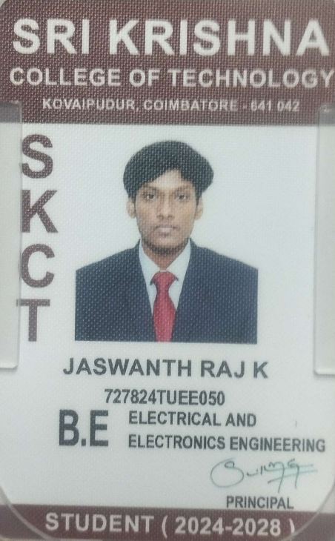
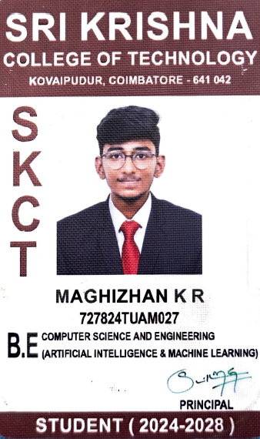
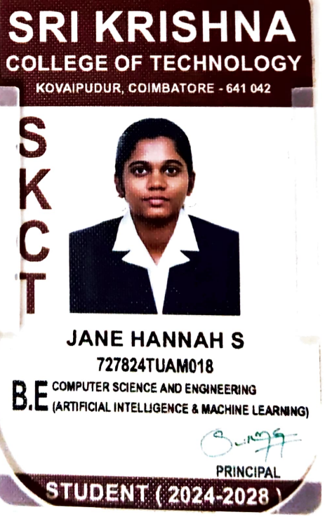
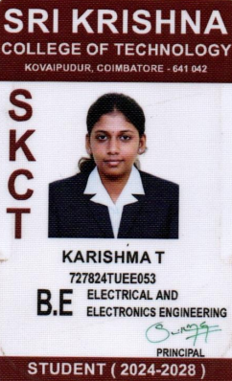
Paste Student ID Card / Entrepreneurs/MSMEs Proofs
JASWANTH RAJ K | MAGHIZHAN K R
JANE HANNAH S | KARISHMA T

Slide 22
THANK YOU
Government of India Ministry of Micro, Small & Medium Enterprises
MSME IDEA Hackathon 5.0

